Slide 1
Online Edu. Employment (Android)
Project Plan
VEL team
14 Aug. 2015

Slide 2
Project Plan
Agenda
1. Team VEL
2. Product Owner
3. Project Goal & Major Capability
4. Product Backlog
5. Development Plan
6. Scrum PM Tool
7. One User Story
8. Risk Management

Slide 3
1. Team VEL

Slide 4
2. Product Owner

Slide 5
3. Project Goal and Major Capability

Slide 6
4. Product Backlog

Slide 7
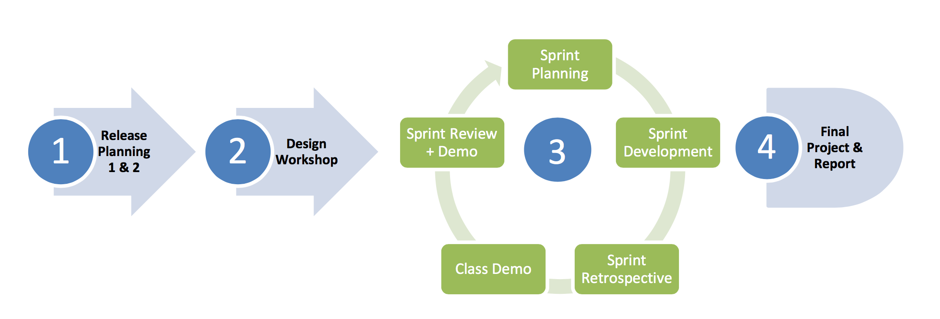
5. Development Plan (1)

Slide 8
5. Development Plan (2)
Design Workshop
Mock up system with minimum functionality and show case of adaption to different size of device will be developed.
Fully customized to adapt desktop/laptop, tablet and mobile phone.
Deliverable consist of a demo system with mock

Slide 9
5. Development Plan (3)
Sprint 1
Core function including main page, course list and course detail, dynamic menu, course category.
Each page will be applied by size adaption framework
Server interaction will be concurrently developed in this sprint.
Deliverable minimum fully functional online course web site, with well tuned adaption to each screen size device

Slide 10
5. Development Plan (4)
Sprint 2
Visitor customized content focus on functionality on recognition of visitor’s personal background, and generate customized content for each type of visitor, display successfully stories and corresponding courses which leads to high possibility of commit deals.
Deliverable consist of visitor recognition functionality, dynamic content, successful stories and corresponding courses.

Slide 11
5. Development Plan (5)
Sprint 3
On-line help desk, shopping cart, and other potential customer requirements. According to the customer, these functionalities need further discussion.
Refinement of product backlog will be done along while project on-going.
Deliverable to be decided.

Slide 12
5. Development Plan (6)
Software Testing
Test scenarios will be designed and test cases will be executed within each sprint.
Including unit testing, integration testing, system testing and customer acceptance tests.
Deliverable consist of test reports.

Slide 13
5. Development Plan (7)
Defect Management
Defect management tool will be used on demands. Defects will be labelled with 3 levels of severity:
Critical – system clash, module level failure, infrastructure failure, etc.
Major – functional misbehavior, missing functionality, etc.
Minor – layout issue, user friendly issue, issues with work around, etc.

Slide 14
5. Development Plan (8)
Software Release
System will be bundled as deployable
Design documents
Test reports
Installation guide
User guide

Slide 15
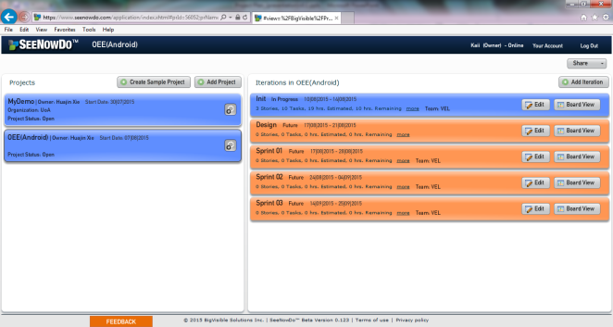
6. Scrum PM Tool (1)
SeeNowDo
URL: https://www.seenowdo.com/pages/login/index.html
Project Name: OEE(Android)
Image of project list & iteration list

Slide 16
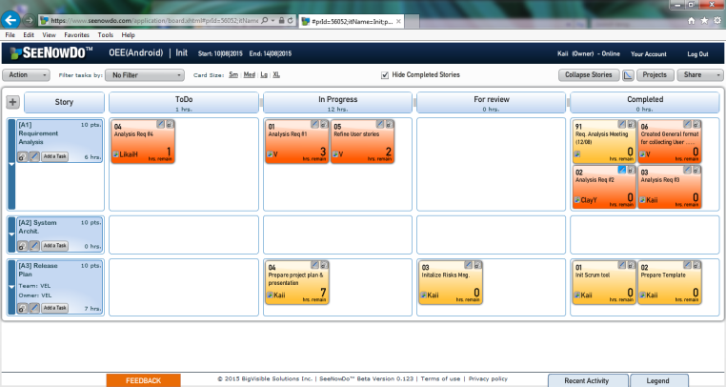
6. Scrum PM Tool (2)
SeeNowDo
Image of User Stories and Tasks List of one sprint

Slide 17
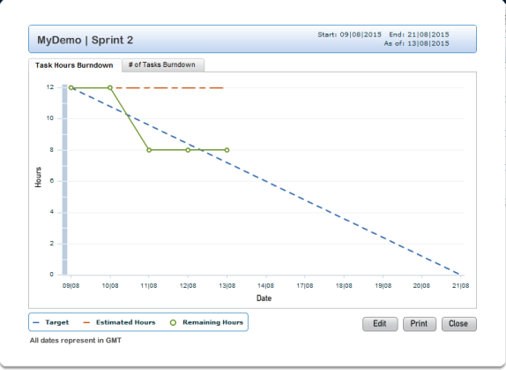
6. Scrum PM Tool (3)
SeeNowDo
Image of Burn-Down Chart

Slide 18
7. One User Story (1)
User story #1
As visitor, when I use mobile devices (phones and pads) to access the website, I want to see that the framework (the header, footer and buttons) of this website is suitable for my using behavior on mobile devices
So that I can use this website on mobile devices as convenient as on PCs.

Slide 19
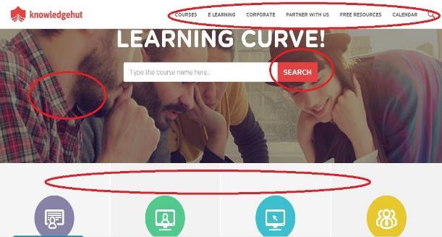
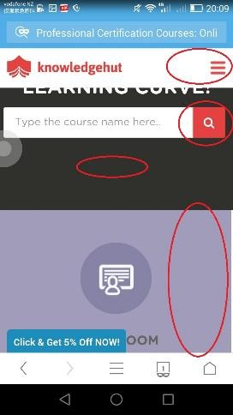
7. One User Story (2)
The menu, button, picture and layout may change from PC to phones.

Slide 20
7. One User Story (3)
User story #1
As visitor, when I use mobile devices (phones and pads) to access the website, I want to see that the framework (the header, footer and buttons) of this website is suitable for my using behavior on mobile devices
So that I can use this website on mobile devices as convenient as on PCs.
DPI & resolution detection
Dynamically changing style
Device type detection

Slide 21
8. Risk Management

